Slide 1

Digital Marketing
Dr. Priyanka Shrivastava

Slide 2
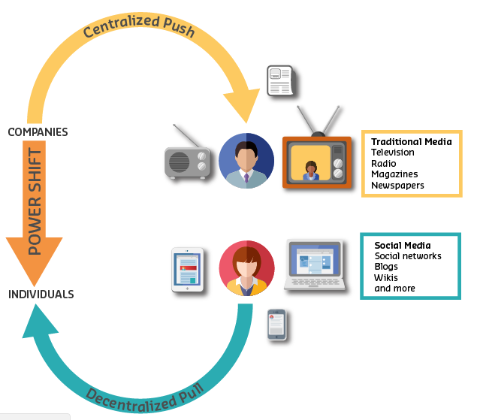
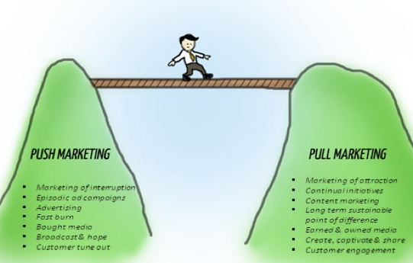
Communication in digital world

Slide 3
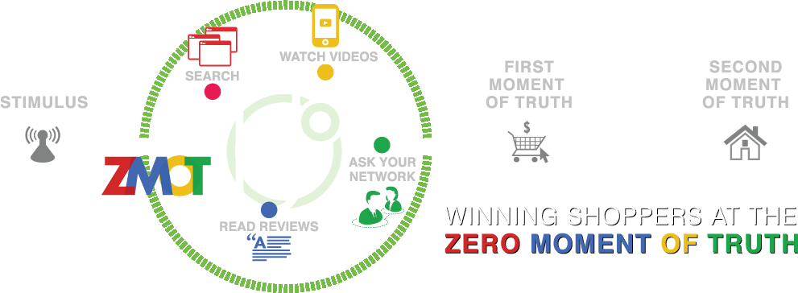
Importance of Digital Presence

Slide 4
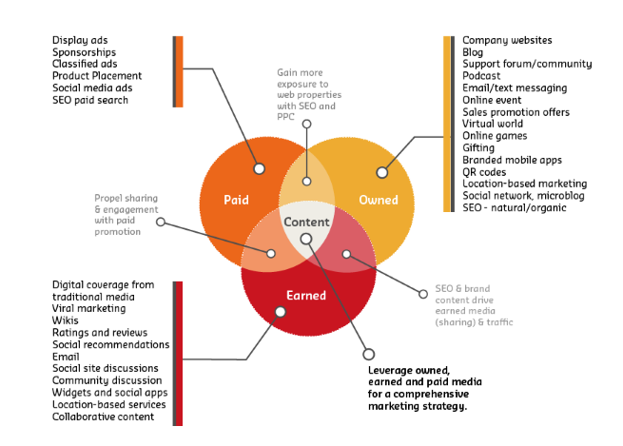
Promotion Strategies in digital world

Slide 5

Effective Website Design
Poll
Are Websites still important?
Is relative level of importance of websites changing?
The fickleness of social media
Loss of control on other platforms
Lack of ownership of key data
A website enables a business to control the context within which the content is delivered

Slide 6
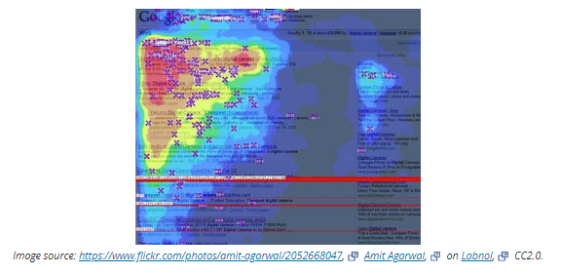
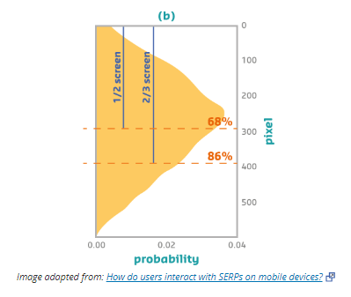
Layout of Website Content

Slide 7
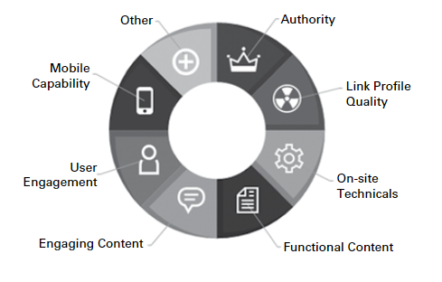
History of SEO
Pre 2003
Keyword density played the major role
Page title, Meta data & Body copy
2004-11
Link Volume
Anchor Text (Clickable text in hyperlink)
2011 onwards
User Experience
Substantially Unique

Slide 8
Search Engine Marketing-SEM
SEO
Keywords
Paid Search
Pay Per Click (PPC)
Anchor Text
User Experience
Cost per impressions (CPM)
Cost per Action (CPA)
“SEM is a form of Digital Strategy that seeks to promote websites by increasing their visibility in search engine results”

Slide 9
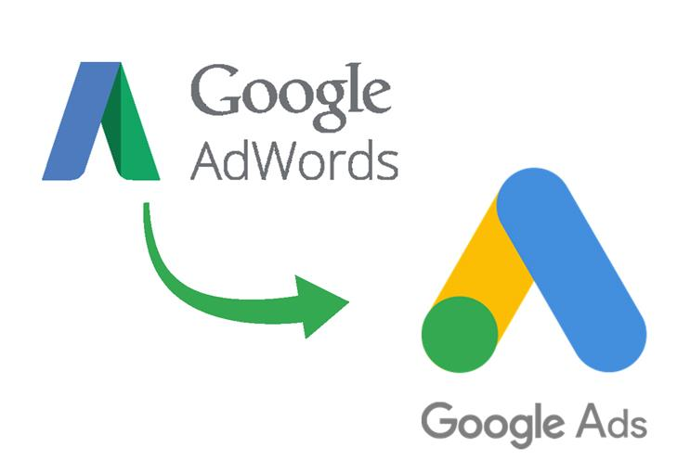
Use negative keywords list
Organize keywords by ad groups
Think like a customer
General Keywords will reach more people
“Broad Match, Phrase Match, Exact Match, Negative Match”

Slide 10
Overview of Optimization Approach
Identify Performance Metrics. Determine the key performance indicators (KPI) to guide analysis and enable SEM result comparisons
Optimize Publisher Strategy. Analyze summarized campaign metrics to determine optimal strategy to pursue for each publisher
Publisher Strategy Options:
Increase publisher funding by purchasing additional keywords
Decrease publisher funding or consider cutting publisher from portfolio
Improve search or website copy
Adjust campaign tactics
Optimize Campaign Strategy. Analyze campaigns within a publisher to determine optimal campaign changes needed to achieve publisher strategy
Calculate KPI Impact. Determine impact of campaign changes on KPIs such as net revenue and ROA

Slide 11
Identify Campaign Metrics
Determine the KPIs to guide analysis and enable comparison of various SEM campaigns
Existing DoubleClick metrics
Cost-per-Click (CPC) measures cost differences among publishers
Click-Through Rate (CTR) measures efficiency of generating clicks from delivered impressions
Transaction Conversion Rate (TCR) measures efficiency of generating sales from delivered clicks
Additional metrics
Net Revenue (Revenue Amount - Cost) measures overall publisher contribution to marketing campaign
Return on Ad $ Spent (ROA) (Net Revenue / Cost) measures efficiency of generating net revenue from ad $ spent
Average Revenue per Booking (Revenue Amount / # of Bookings) measures differences in revenue capture and may be indicative of differing customer segments captured by publishers
Probability of Booking (CTR * TCR) measures the probability of generating a sale from a delivered impression
Use PivotTables to summarize metrics for each publisher

Slide 12
Identify Campaign Metrics (cont’d)
Key Observations
Although Google U.S. has high net revenue and volume, it also has the most expensive average cost per click
Yahoo has the highest ROA and high net revenue
Though similar in scale, MSN performs much better than Overture mainly due to differences in probability of booking

Slide 13
Optimize Publisher Strategy—Method
Graph publishers on a bubble chart using the following dimensions: X=Probability of Booking, Y=Cost Per Click, Bubble Size=Total Costs or Total Funding
Create four quadrants by drawing a line at the publisher average for CPC and another line at the publisher average for probability of booking
Observe the quadrant in which a publisher falls and assign a strategy using the table below
Bubble size indicates current funding levels

Slide 14
Optimize Publisher Strategy—Results
Quadrant 1
Quadrant 2
Quadrant 3
Quadrant 4

Slide 15
Optimize Publisher Strategy—Key Takeaways
CPC and probability to produce a sale differ among publishers
Quadrant position can be used to determine optimal publisher strategy
Results
Quadrant 1: No publishers present.
Quadrant 2: Google Global, Google U.S., and MSN U.S. have a high probability of booking but high CPC. Deploy strategy to reduce CPC through tactical campaign changes.
Quadrant 3: Yahoo U.S. and MSN Global have a high probability to book and low CPC. Deploy strategy to fund these publishers more.
Quadrant 4: Overture U.S. and Overture Global have a low probability of booking but acceptable CPC. Deploy strategy to improve CTR and/or TCR of Overture campaigns through copy improvements.

Slide 16
Optimize Campaign Strategy—Overture
Analyze Overture campaigns using bubble chart with the following dimensions: X=CTR, Y=TCR, Bubble Size=Net Revenue
Poor search-side copy will negatively impact CTR
Poor website-side copy will negatively impact TCR
Improving CTR or TCR will improve a publisher’s booking probability, positively impacting net revenue and ROA
Potential campaign improvements
Improve search-side copy if low CTR
Change website-side copy if low TCR
Consider eliminating low net revenue campaigns if low CTR and low TCR

Slide 17
Optimize Campaign Strategy—Overture (cont’d)

Slide 18
Optimize Campaign Strategy—Google and MSN U.S.
Use PivotTable to summarize the tactics of campaigns with a high ROA
Tactics to change include: keyword, match type, average position, and bid strategy
High-ROA campaigns are performing well despite the high CPC of these publishers
Apply common tactics of high-performing campaigns to low-performing campaigns within the publisher

Slide 19
Optimize Campaign Strategy—Google and MSN U.S. (cont’d)

Slide 20
Optimize Campaign Strategy—Google and MSN U.S. (cont’d)

Slide 21
Optimize Campaign Strategy—Google and MSN U.S. (cont’d)

Slide 22
Calculate KPI Impact—Recommendations for Top Tier Search Engines
Increase marketing for search engines with a high probability to book and low CPC charges
MSN Global and Yahoo U.S.
Improve probability of booking for search engines with a low CTR and low probability to book
Overture U.S. and Overture Global
Improve ROA of campaigns for high CPC search engines with high probability to book
Google U.S., Google Global, and MSN U.S.

Slide 23
Calculate KPI Impact—Recommendation 1

Slide 24
Calculate KPI Impact—Recommendation 2

Slide 25
Calculate KPI Impact—Recommendation 3

Slide 26
Metasearch Engine—Kayak
Kayak searches airline and travel websites to offer best deals
Differentiated from Orbitz, Expedia, and Travelocity because those companies pre-purchase inventory
Search and clickstream data not integrated with DoubleClick
Aggregate performance indicates 0.8% CTR higher than airline industry average
Extrapolate weekly report to improve performance

Slide 27
Kayak Recommendation
Increase marketing with Kayak

Slide 28
Summary and Key Takeaways
Increasing funding with a high probability of booking/low CPC publisher will have greatest impact on net revenue and ROA
Low booking probability/low CPC publishers should be targeted for copy improvements
Copy improvements that increase CTR and/or TCR will have the second greatest impact on net revenue and ROA
High booking probability/high CPC publishers should be targeted with tactical campaign changes indicative of high ROA campaigns
Steps to Optimize Sponsored Search:
Summarize Campaign Metrics
Optimize Publisher Strategy
Optimize Campaign Strategy
Calculate KPI Impact
Consider other market player effects such as metasearch engines and affiliates
Act on recommendations to measure assumptions
Due to almost immediate access to data and ability to halt/modify campaigns on the fly, recommendation testing is not risky.

